Slide 1

KTO KARATAY UNIVERSITY
FACULTY OF ENGINEERING
MECHATRONICS ENGINEERING DEPARTMENT
MEM524 SYSTEM DYNAMICS
PROJECT PRESENTATION
MUSTAFA URGAN
MUSTAFA POLAT
200313017
200313008
<04.01.2024>

Slide 2
TABLE OF CONTENTS
INTRODUCTION .…………………………………………………………………… 2
PROJECT ...…………………………………………………………………………... 3
DEPARTMENT OF ELECTRIC .….…………………………………………………. 4
DEPARTMENT OF MECHANIC…………………………………………………….. 6
TRANSFER FUNCTION …..………………………………………………………… 8
MATLAB SIMULINK, SIMSCAPE AND TRANSFER FUNCTION GRAPHS …… 9

Slide 3
INTRODUCTION
This project titled Shaft Starting with Electric Rotor has been prepared in accordance with the System Dynamics course curriculum.
Project Objectives:
It is to analyse the theoretical knowledge seen in the course on a system or to make a design with this information.
This system or design is modelled mathematically and analysed through MATLAB software.
To improve ourselves in the face of the problems encountered, to improve our ability to search and learn.
To learn how to use MATLAB software, to analyse and at least to compare the theoretical and practical knowledge and to make comments.

Slide 4
PROJECT
The project is an electromechanical system consisting of electrical and mechanical parts.
A rotor is connected to the electric DC motor. This rotor provides a rotational movement by moving with the armature current.
The armature in electric motors is a coil rotating in a magnetic field. This coil is wound on a rotating shaft (rotor).
A rigid shaft is connected to this rotor. This shaft has a mechanical part consisting of two masses and a damper element and a spring element.
The electrical part of the project is inspired by electric motors and the mechanical part is inspired by the flexible shaft in the MATLAB Simscape library.
The project was simulated and analysed through MATLAB Simulink and Simscape by making mathematical calculations.

Slide 5
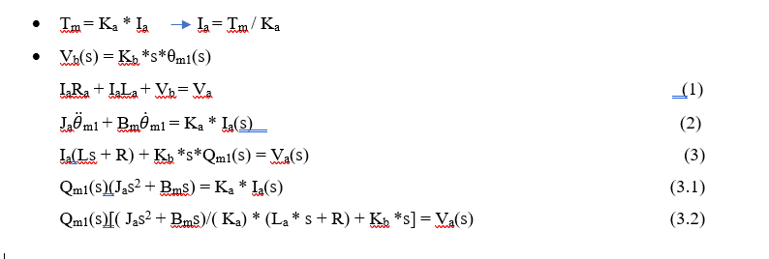
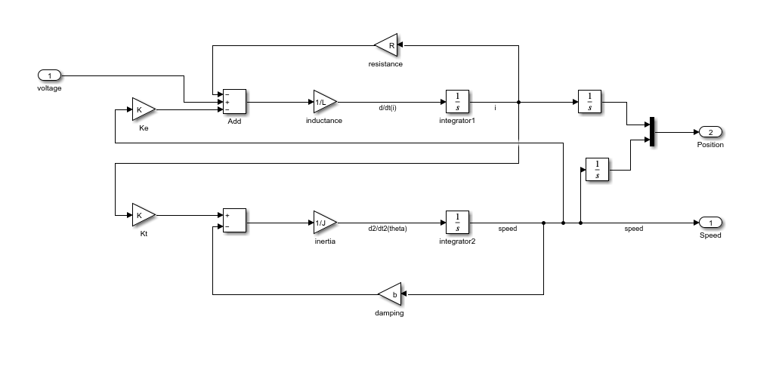
DEPARTMENT OF ELECTRIC
The mathematical model of the electrical part of the project was created and block diagrams were prepared in MATLAB Simulink programme.

Slide 6
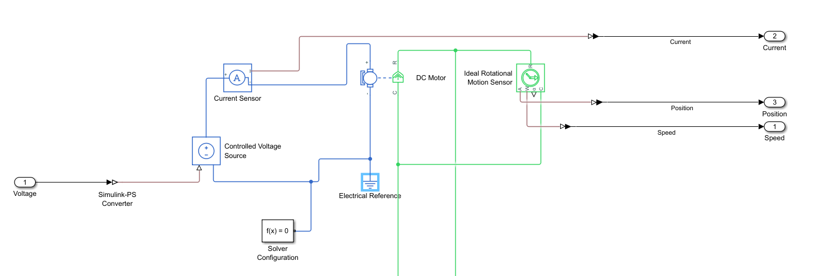
Simscape simulation of the electrical part of the project was prepared by using the library and calculations.
Simscape simulation is shown in the picture below.

Slide 7
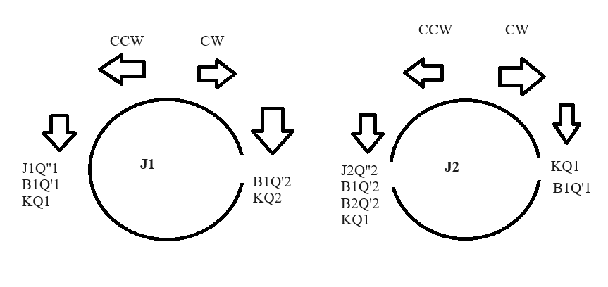
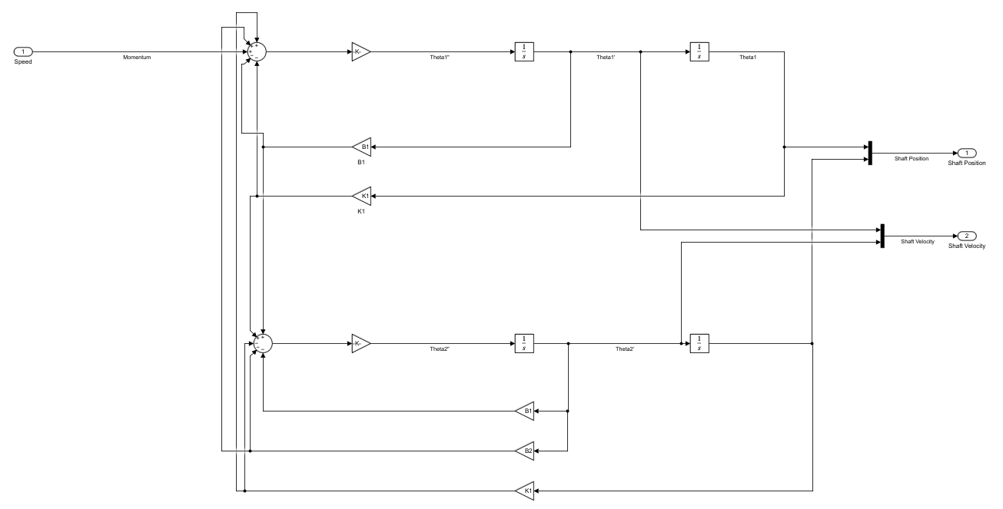
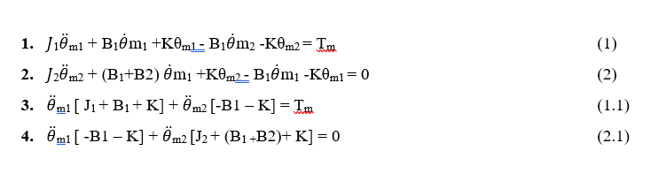
DEPARTMENT OF MECHANICAL
The mathematical model of the mechanical part of the project was created and block diagrams were prepared in MATLAB Simulink programme.

Slide 8
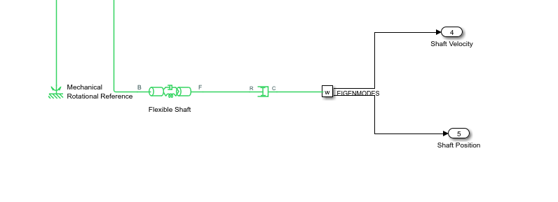
Simscape simulation of the mechanical part of the project was prepared using the library and calculations.
Simscape simulation is shown in the picture below.

Slide 9
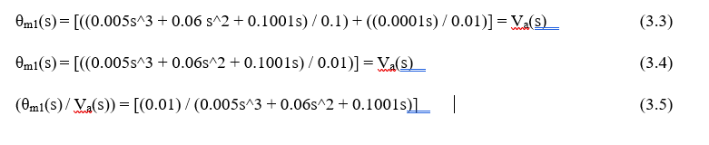
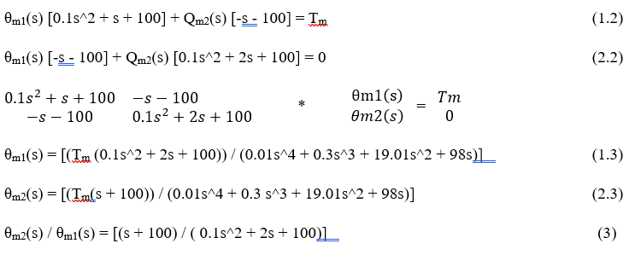

TRANSFER FUNCTION
In the project, the transfer function of the system was calculated using the theoretical knowledge and mathematical calculations seen in the course and compared with Simulink and Simscape outputs.
Electrical Section Transfer Function | Mechanical Section Transfer Function
Transfer Function of Electromechanical System

Slide 10
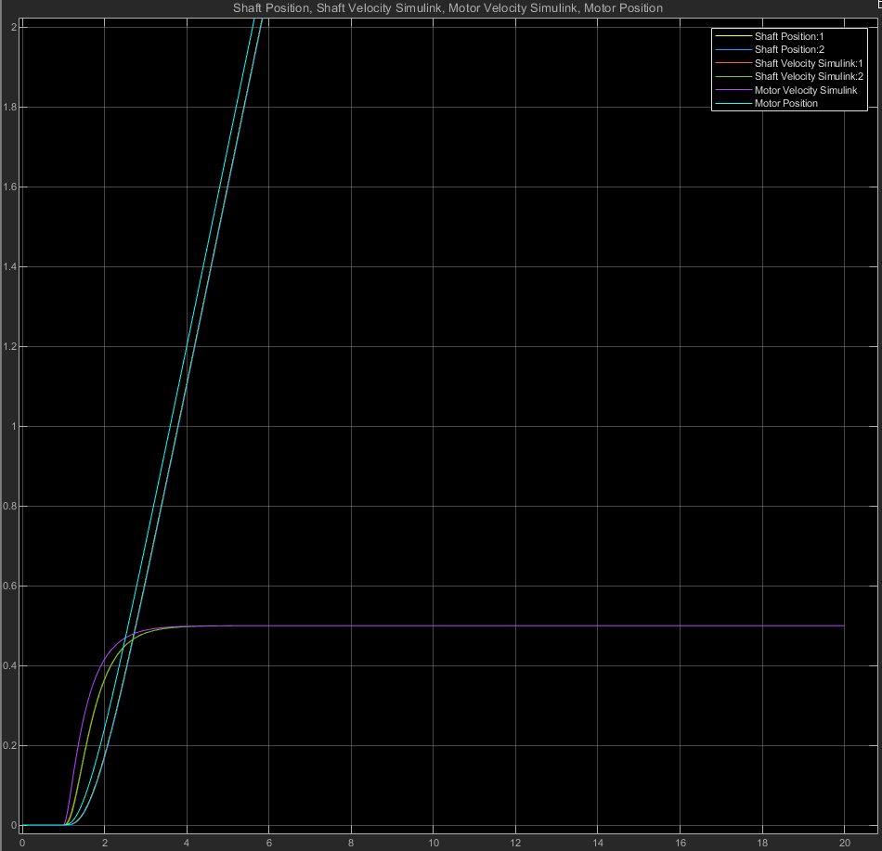
MATLAB SIMULINK, SIMSCAPE AND TRANSFER FUNCTION GRAPHS
MATLAB Simulink graph is given below.

Slide 11
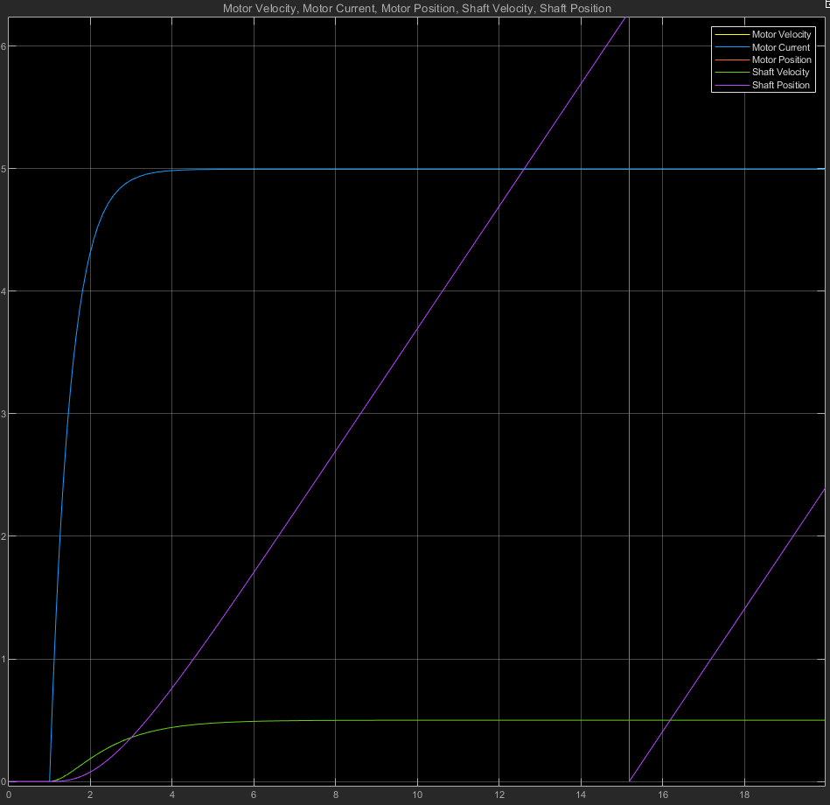
MATLAB Simscape graph is given below.

Slide 12
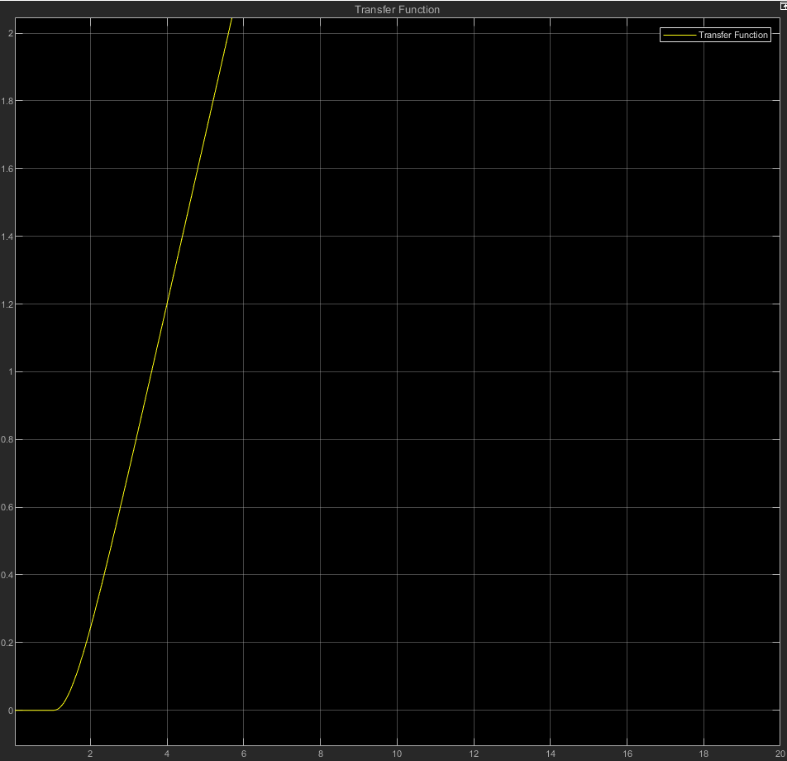
The transfer function graph is given below.

Slide 13
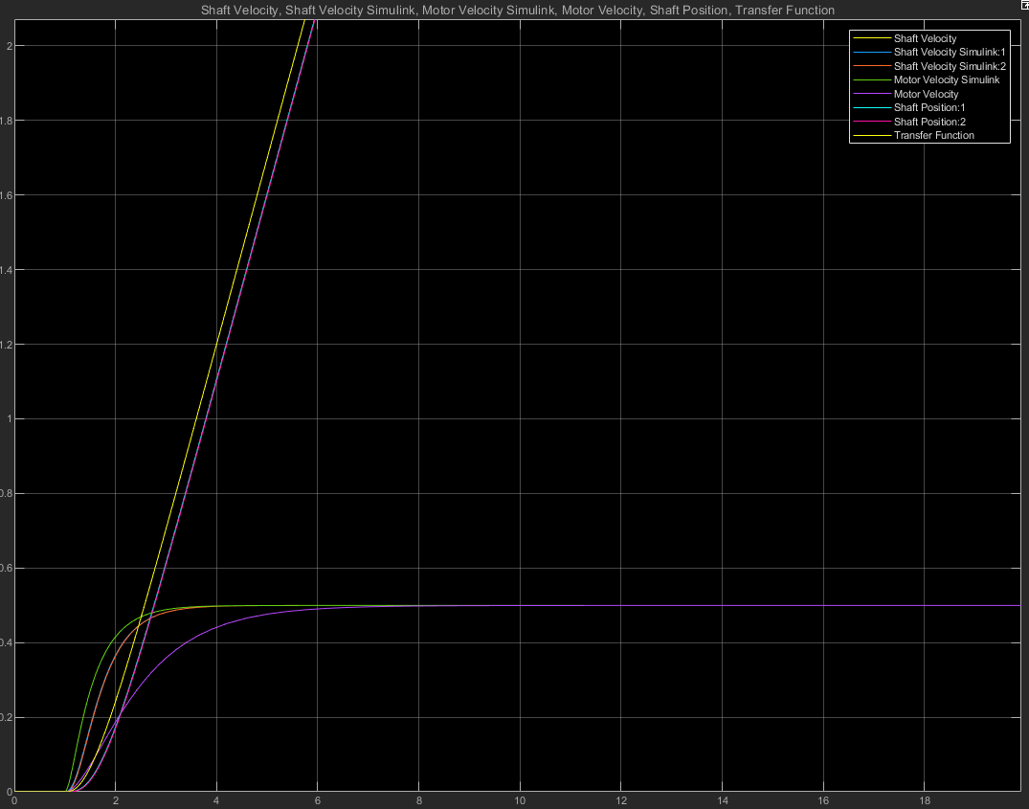
In the graphs below, MATLAB Simulink, Simscape outputs and transfer function output are displayed on a single scope.

Slide 14
THANK YOU FOR LISTENING PATIENTLY.

